Slide 1
Developing a Program that determines the braid index of alternating links
Caitlin Cook & Grace McClurg

Slide 2

INTRODUCTION TO KNOT THEORY

Slide 3
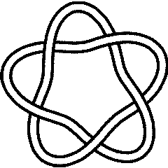
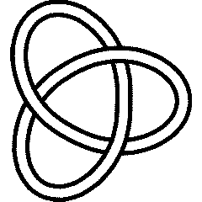
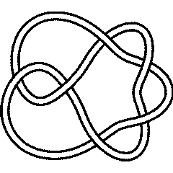
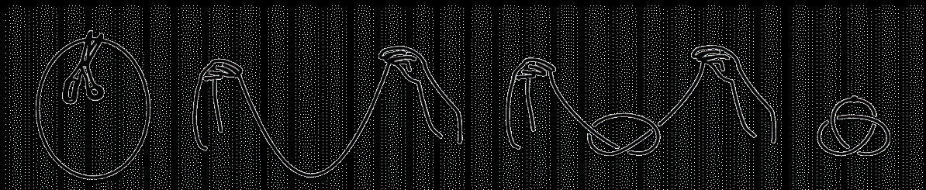
KNOTS
Knots are tangled in a way in which they cannot possibly be unwound to produce a simple loop without opening the curve. The unknot is an exception to this as it is a simple loop itself.
You can imagine a knot as a string that is first knotted then its ends are glued together.
Knot Diagrams

Slide 5
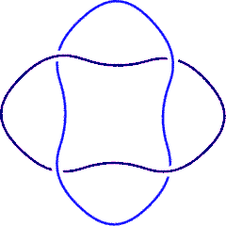

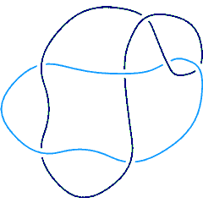
Links
A link is set of one or more knots that are linked together, but do not intersect, and cannot be separated without opening one or more of the curves.
Link Diagrams

Slide 6

Alternating links and knots
A link or knot is considered alternating if when tracing around each of its strands, it alternates between being an over strand and being an under strand
Over Under Over
Under Over Under
Alternating crossings

Slide 8
Alternating Link Diagram

Slide 9
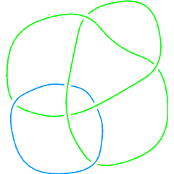
Non-alternating link

Slide 10


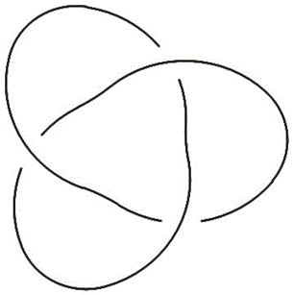
crossings
A crossing occurs when a diagram of a knot or link intersects itself
Negative crossings occur when the strand on top is oriented right to left
Positive crossings occur when the strand on top is oriented left to right
+
-
Labeled crossings

Slide 11
crossings
A crossing occurs when a diagram of a knot or link intersects itself
Negative crossings occur when the strand on top is oriented right to left
Positive crossings occur when the strand on top is oriented left to right
+
-
Labeled crossings

Slide 12
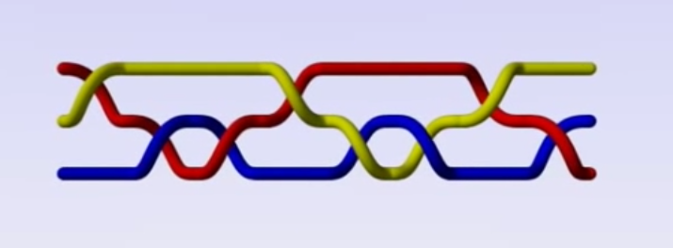
Braids
Every knot or link has a braid representation.
Every knot or link has a braid representation.
A braid is a collection of intertwined strings that each have two endpoints.

Slide 13
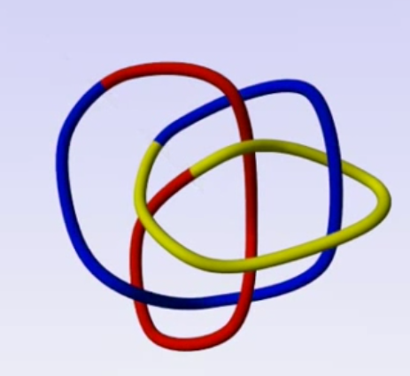
Braids
Every knot or link has a braid representation.
Every knot or link has a braid representation.
A braid is a collection of intertwined strings that each have two endpoints.
To turn a link into a braid, cut through a link and stretch it out so that the endpoints of each of the strings appear on opposite sides.

Slide 14
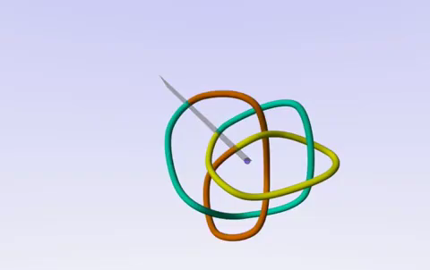

Braids

Slide 15
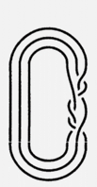

Braid INDEX
The braid index of a link is the least number of strings that can be used to create a braid representation.
This link, for example, has a braid index of 3
Link
Braid

Slide 16
OUR OBJECTIVE
Our objective is to be able to determine the braid index for Montesinos links.
Our first increment determines the braid index of a two-bridge link (a specific type of Montesinos link),which is represented as a list of integers.

Slide 17
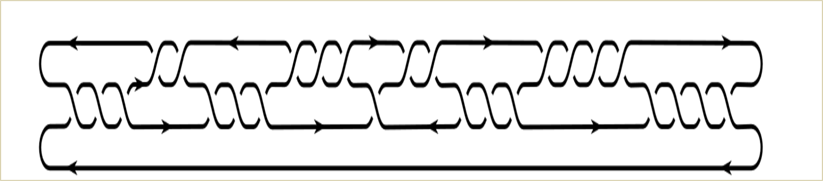
Construction of a two-bridge link
Imagine the link as a collection of sets of crossings represented by a set of integers. Each set alternates between involving strands at positions 1-2 and 2-3, as indicated by the figure.
Sequence: (4,4,3,2,1,3,3,2,3)
Set Labels:
9 8 7 6 5 4 3 2 1
1
2
3
4
Strand positions

Slide 18

Sequence: (4,4,3,2,1,3,3,2,3)
Set Labels: 1
1
2
3
4
Strand positions

Slide 19
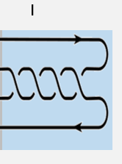
Sequence: (4,4,3,2,1,3,3,2,3)
Set Labels:
1
2
3
4
Strand positions

Slide 20
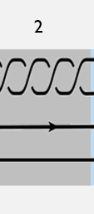
Sequence: (4,4,3,2,1,3,3,2,3)
Set Labels:
1
2
3
4
Strand positions

Slide 21
Sequence: (4,4,3,2,1,3,3,2,3)
Set Labels:
9 8 7 6 5 4 3 2 1
1
2
3
4
Strand positions

Slide 22
SIGNED VECTOR
A signed vector indicates whether the crossings within a crossing set are positive or negative. All crossings within a set have the same sign.
+
3 2 3 3 - 1 - 2 - 3 4 - 4
-
Unsigned Vector: (4,4,3,2,1,3,3,2,3)
Signed Vector: (-4,4,-3,-2,-1,3,3,2,3)

Slide 23
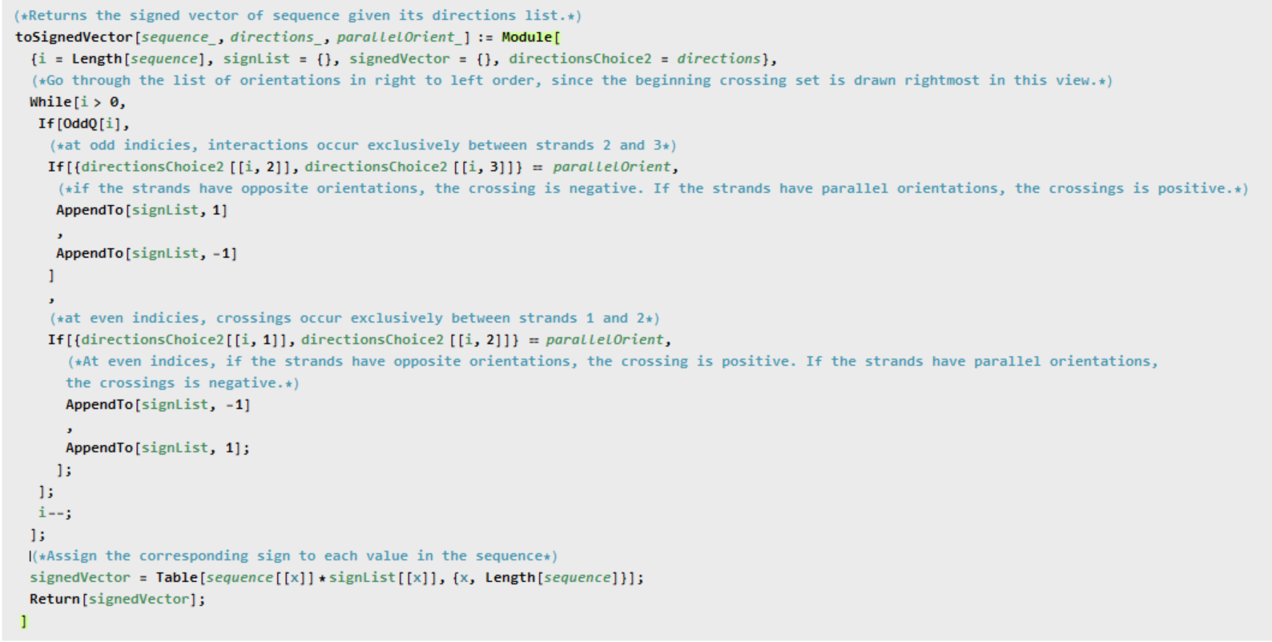

Slide 24
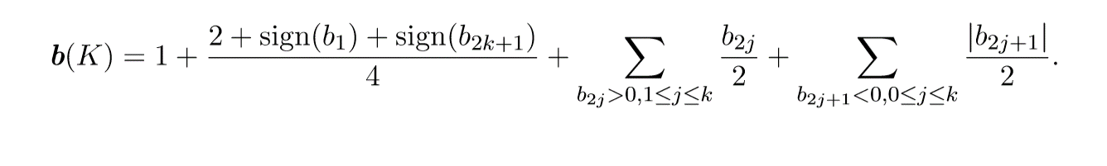
Determining the braid index
Once we determine the signed vector representing a two-bridge link, we can determine its braid index using the formula below

Slide 25
OUR OBJECTIVE
Our objective is to be able to determine the braid index for Montesinos links.
Our second and third increments determine the braid index of a general Montesinos link.

Slide 26
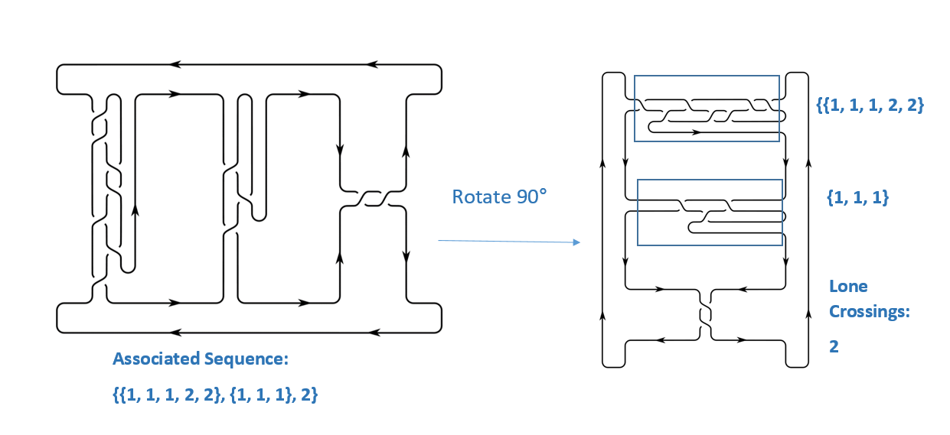
Montesinos links
Montesinos links can be thought of as two-bridge links that are fused together and then rotated 90 degrees

Slide 27
Montesinos links
Montesinos links can be thought of as two-bridge links that are fused together and then rotated 90 degrees

Slide 28
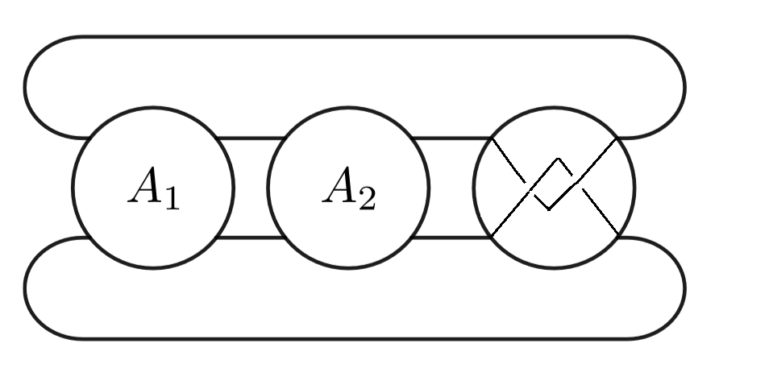
Montesinos links
After rotations, you can see this produces a Montesinos link made of the tangle sequences. Each two-bridge component is called a tangle.

Slide 29
Signed vectors for m links
We need the directions of the four incoming strands of each tangle to determine the signed vectors for each tangle.
The fourDirectionsOfmLink method accomplishes this by tracing around the link

Slide 30
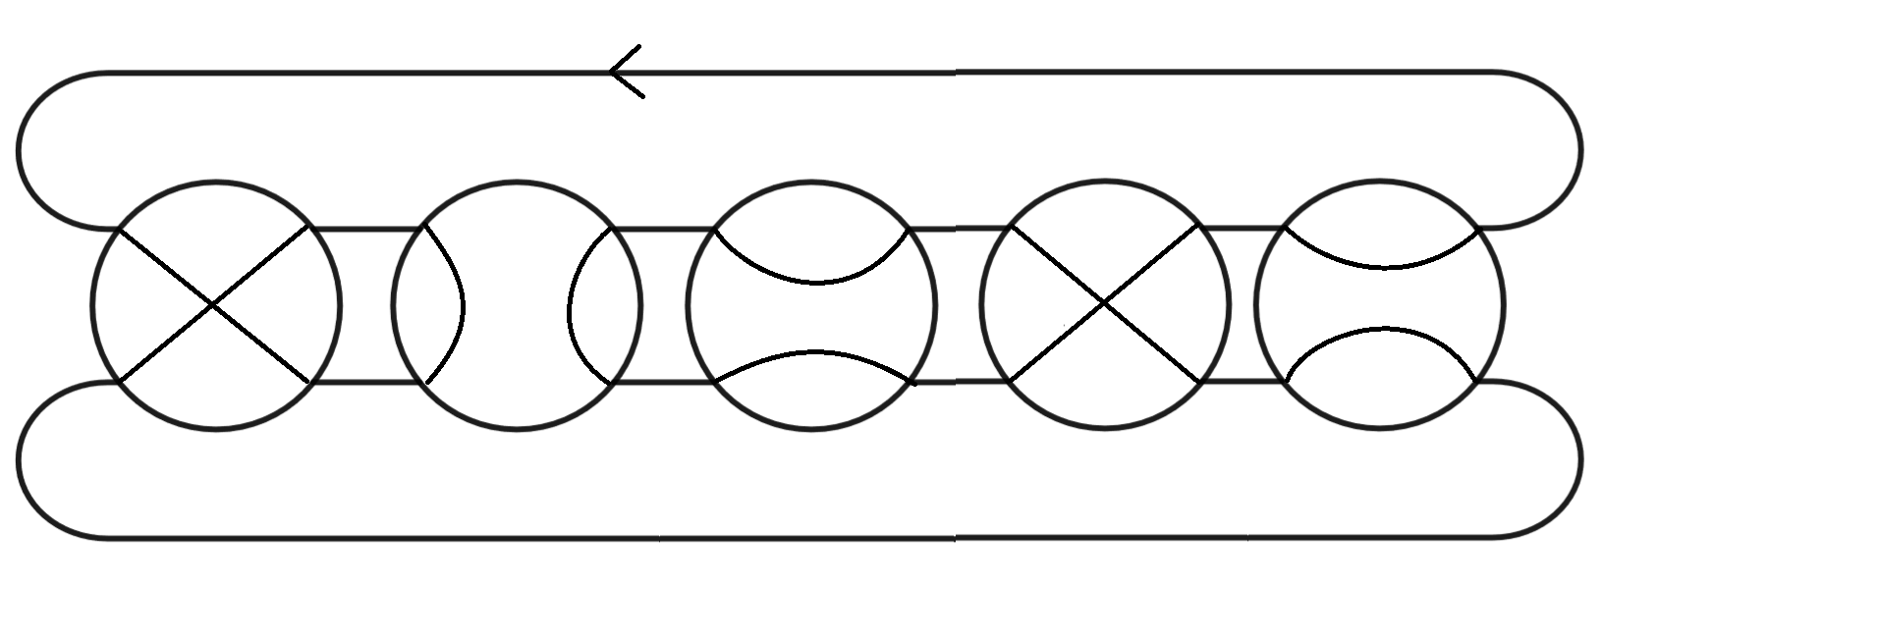
Four Directions of M link method

Slide 31
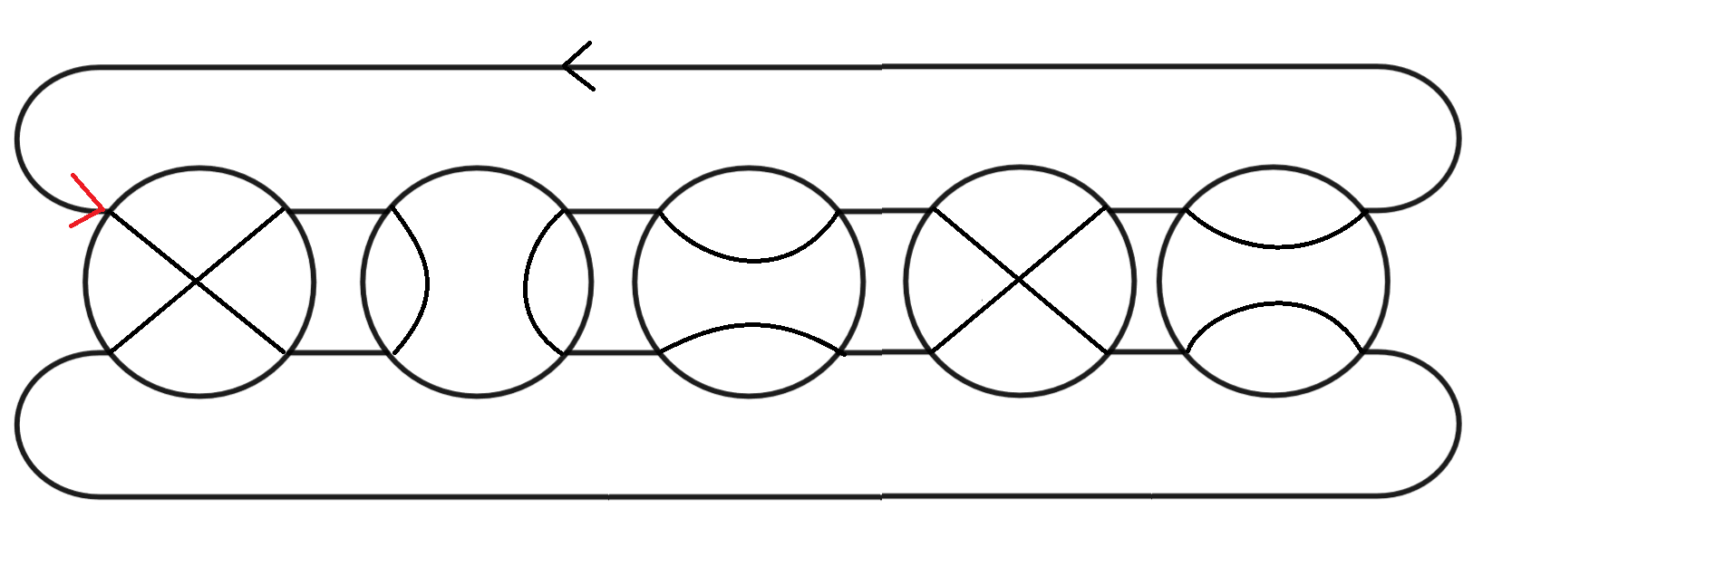
Four Directions of M link method

Slide 32
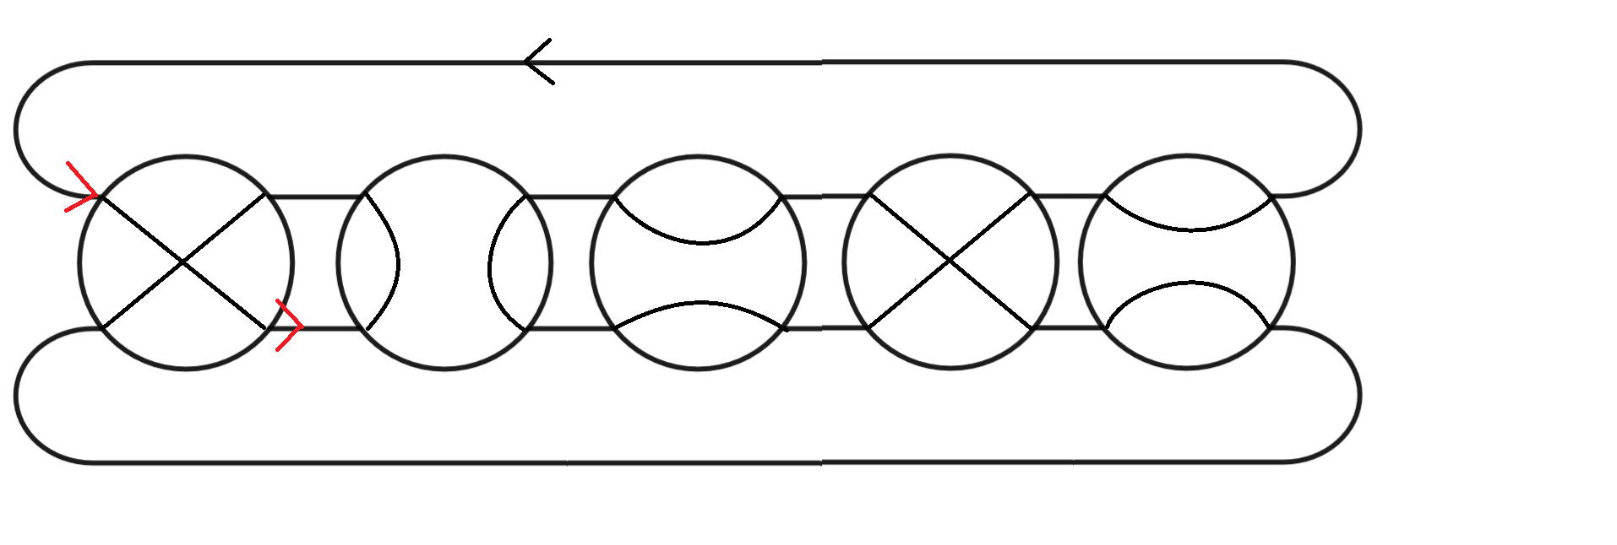
Four Directions of M link method

Slide 33
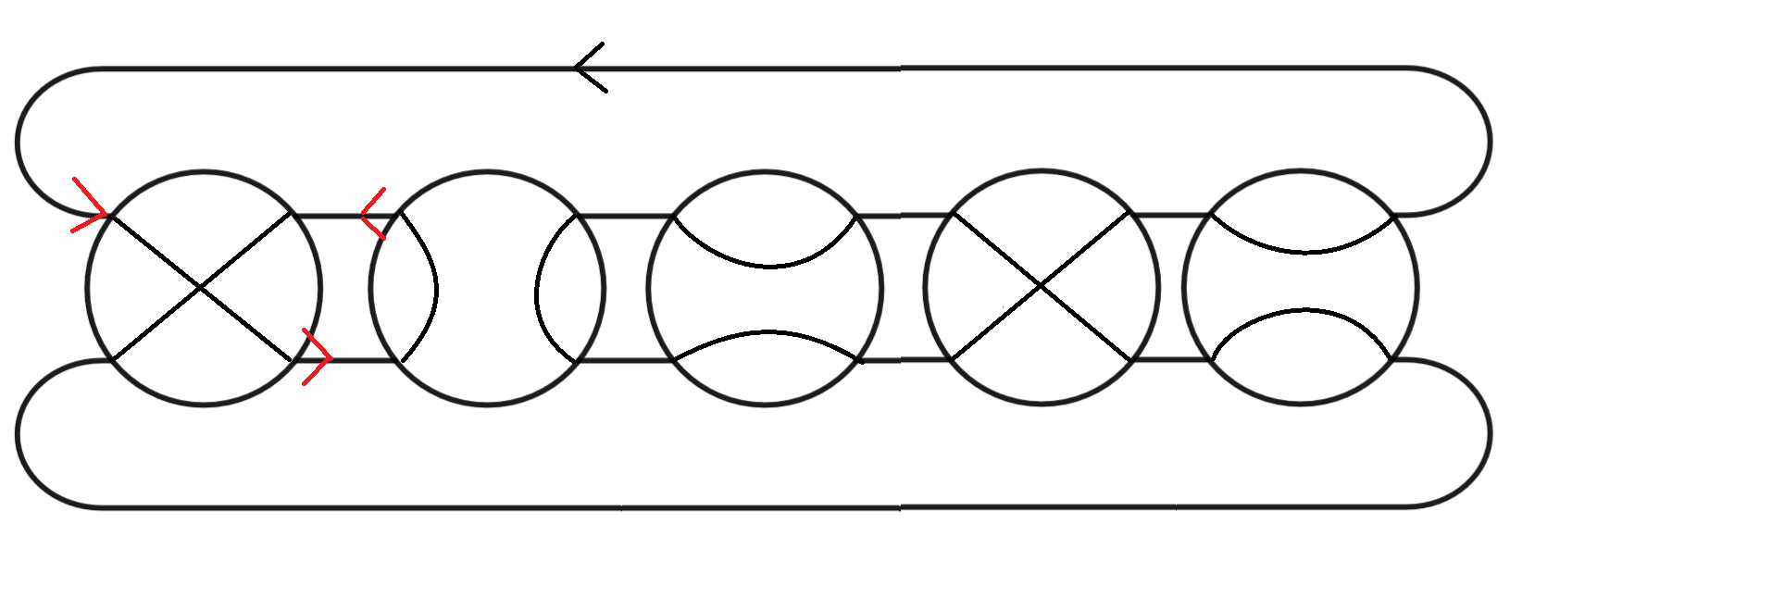
Four Directions of M link method

Slide 34
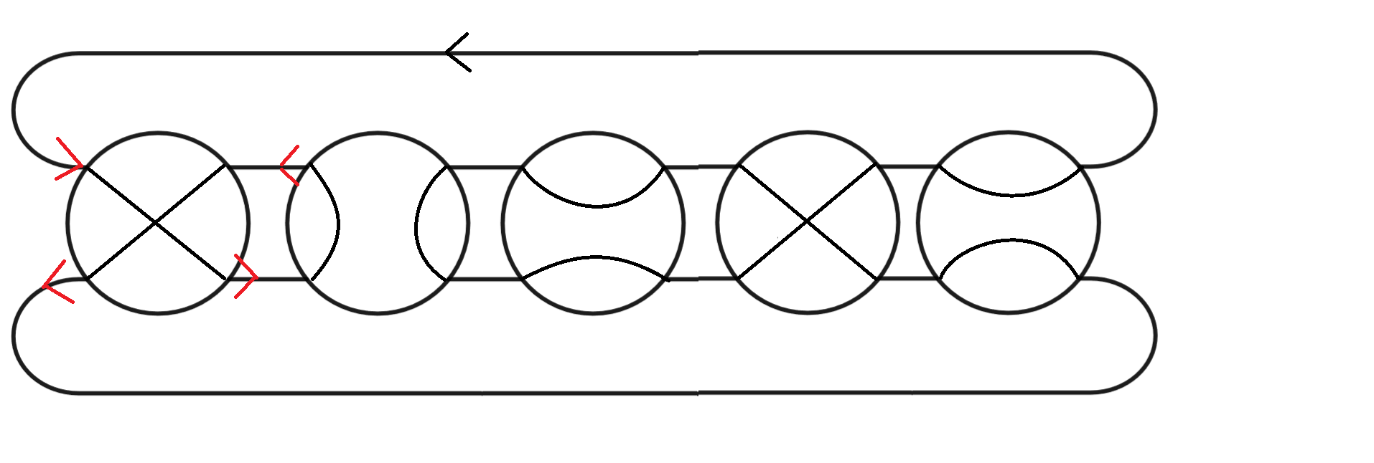
Four Directions of M link method

Slide 35
Four Directions of M link method

Slide 36
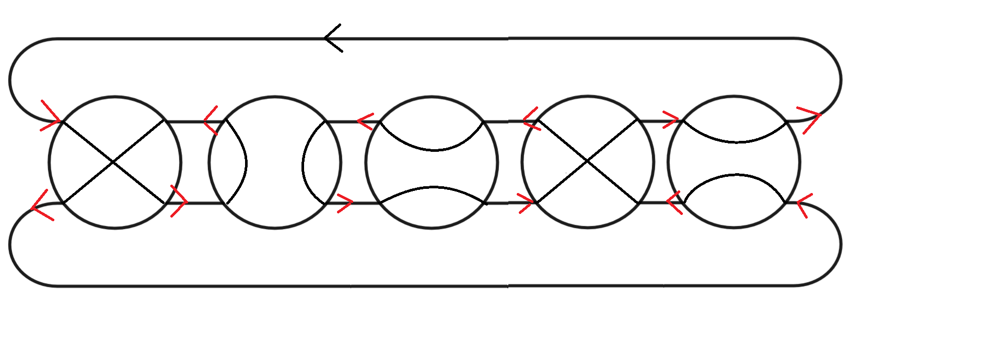
Four Directions of M link method

Slide 37
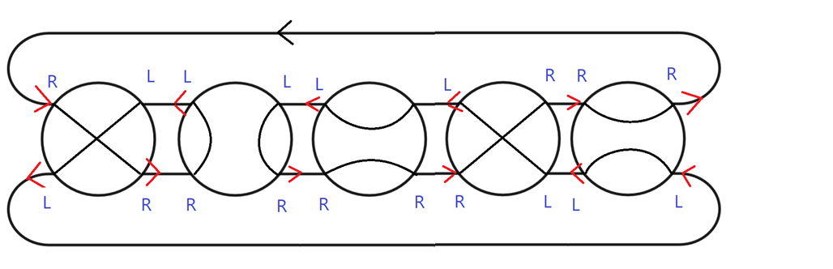
Four Directions of M link method
{{“L”, “R”, “R”, “L”}, {“R”, “L”, “R”, “L”}, {“R”, “L”, “R”, “L”}, {“R”, “L”, “L”, “R”}, {“L”, “R”, “L”, “R”}}

Slide 38
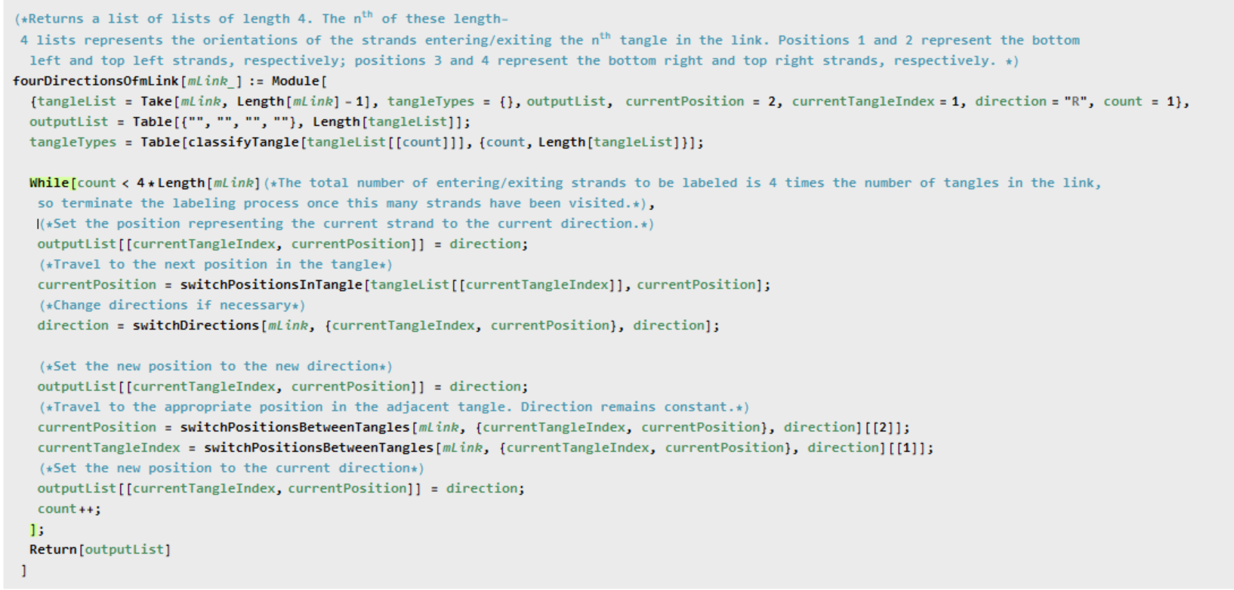

Slide 39
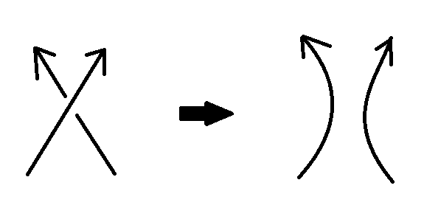
Seifert decomposition
A Seifert Decomposition of a link is a set of regions resulting from “smoothing” each crossing in the link diagram in the following way:

Slide 40
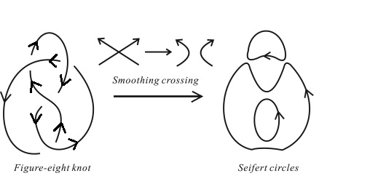
Seifert decomposition
An example of a Seifert decomposition:
https://www.sciencedirect.com/science/article/pii/S0022519314003464

Slide 41
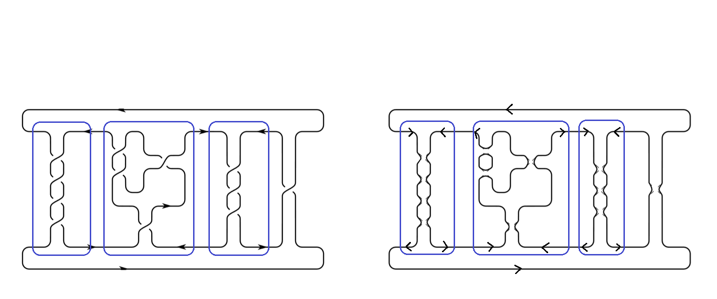
Seifert decomposition
We use the information about the arcs traveling into and out of each two-bridge tangle in the Seifert decomposition of the link to decide which formula to apply

Slide 42
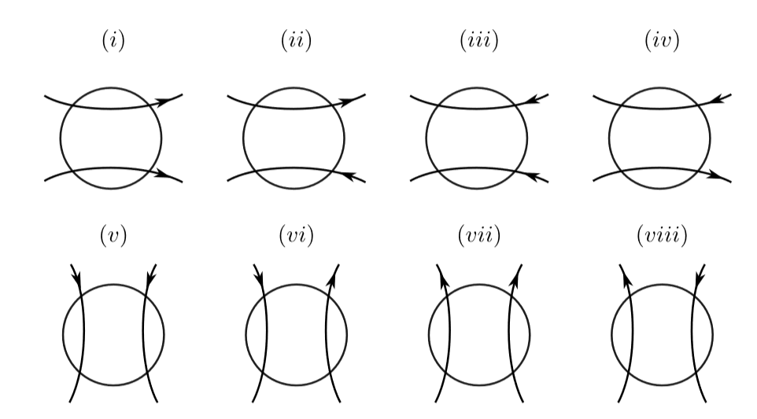
Seifert decomposition
We label each tangle as one of the categories below

Slide 43
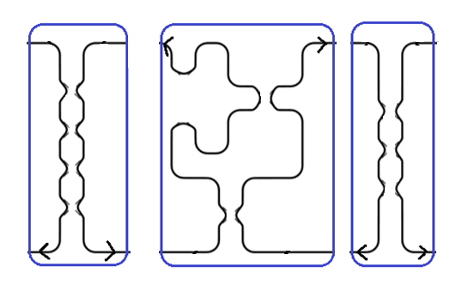
Seifert decomposition
We label each tangle as one of the categories below
(v)
(vii)
(v)

Slide 44



Seifert decomposition
We label each tangle as one of the categories below.
If the link contains only tangles of type (i), it is an M1 link.
If the link contains only tangles of type (ii), it is an M2 link.
Otherwise, the link is a type B link.

Slide 45
Seifert decomposition
We label each tangle as one of the categories below
(v)
(vii)
(v)

Slide 46
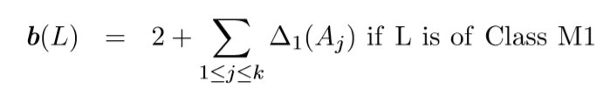


Formulas for the types of m links

Slide 47
Example
{{4},{1,1,2},{3},1}
Seifert decomposition diagram

Slide 48
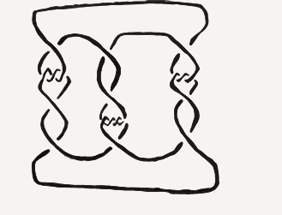
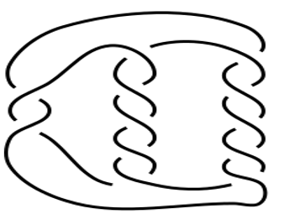
Future work
Extending the class of links with braid index that can be computed algorithmically
One class of non-alternating link for which the braid index can be computed with information from its HOMFLY polynomial (a link invariant) is the non-alternating pretzels
We are currently working on finding more classes of non-alternating links for which this is true

